Slide 1
Investigating the Effectiveness of
Process-Product Oriented and Process Oriented
Worked Examples to Support Pre-service Teachers Engaging with the NSW Quality Teaching Model
Gerry Sozio
10th International Cognitive Load Theory Conference
University of Wollongong
November 2017
Supervisors: Dr Shirley Agostinho & Dr Sharon Tindall-Ford
Associate Supervisor: Professor Fred Paas

Slide 2

Background to the Study
Worked examples:
Decrease extraneous load
Increase Working Memory resources for learning
Increase in performance (Paas and Van Gog, 2008)
“Worked examples are an effective instructional means to teach complex problem solving skills.” (Paas, 2006)

Slide 3
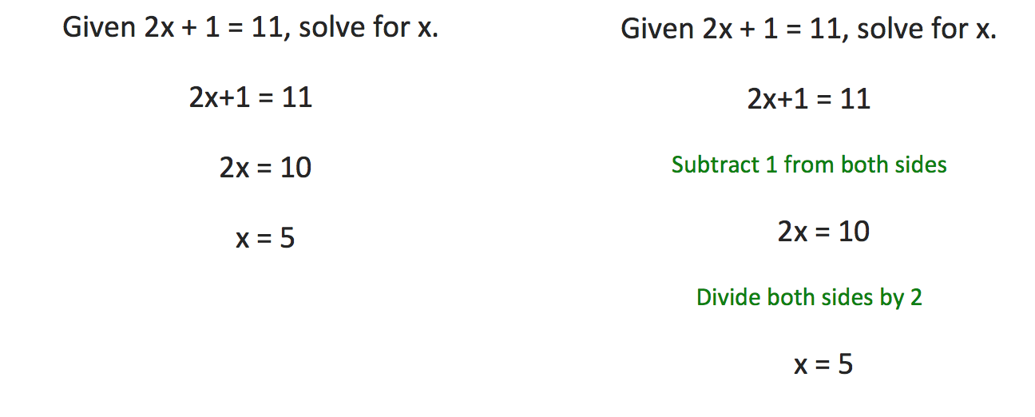
Worked Examples in a
Well Structured Environment
Product Oriented Worked Example
Process-Product Oriented Worked Example
Steps to solutions
Steps to solutions & reasoning

Slide 4
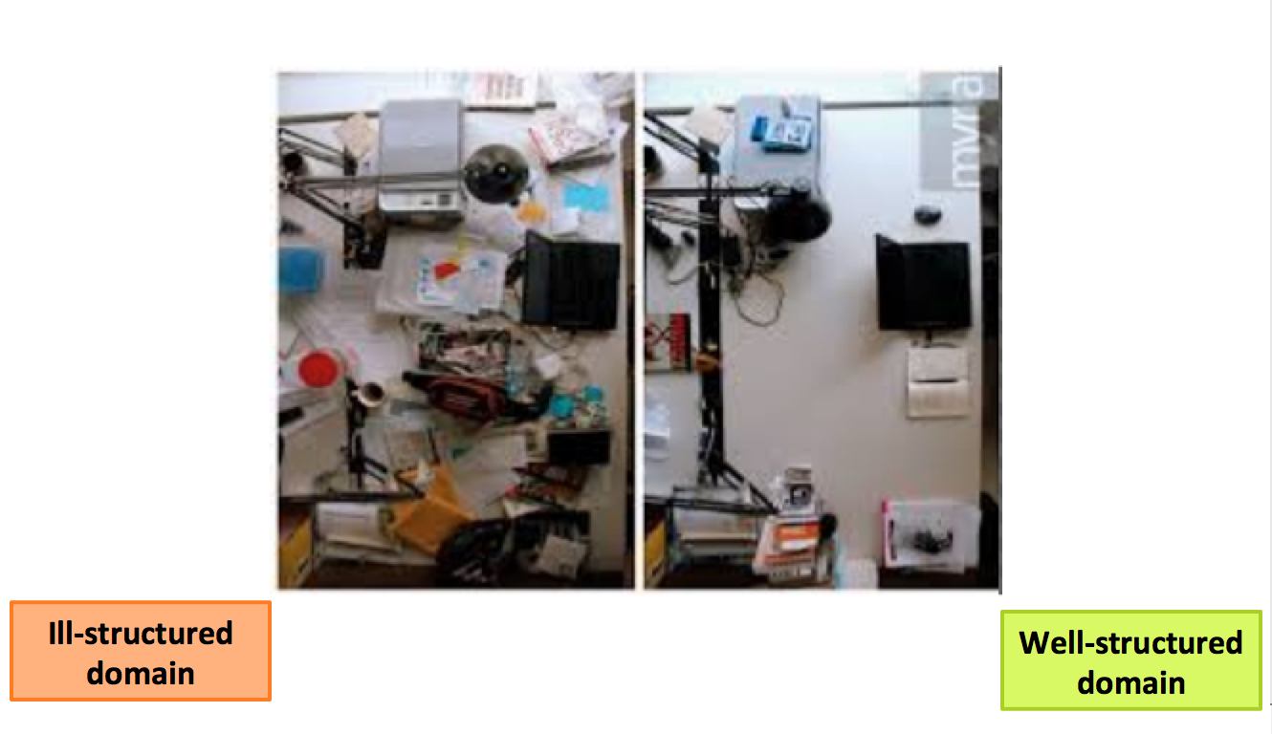
Ill-Structured v Well-Structured

Slide 5
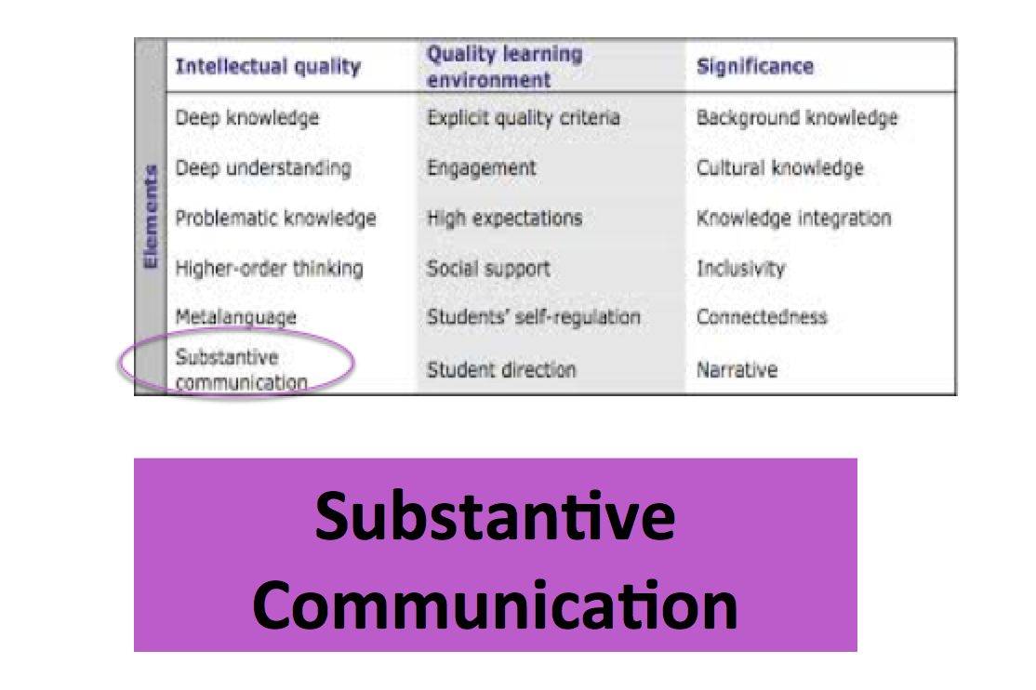
NSW Quality Teaching Model
Notes:
Need to state what substantive communication looks like – have a slide that summarizes key features

Slide 6

Substantive Communication
Students are regularly engaged in sustained conversations about the concepts and ideas they are encountering
These conversations can be expressed in oral, written or artistic form
This element identifies the quality of communicating required to promote cogent understanding
Characteristics of a lesson with a high level of Substantive Communication
There is sustained interaction
These communication is focused on the substance of the lesson
This interaction is reciprocal (two-way)

Slide 7
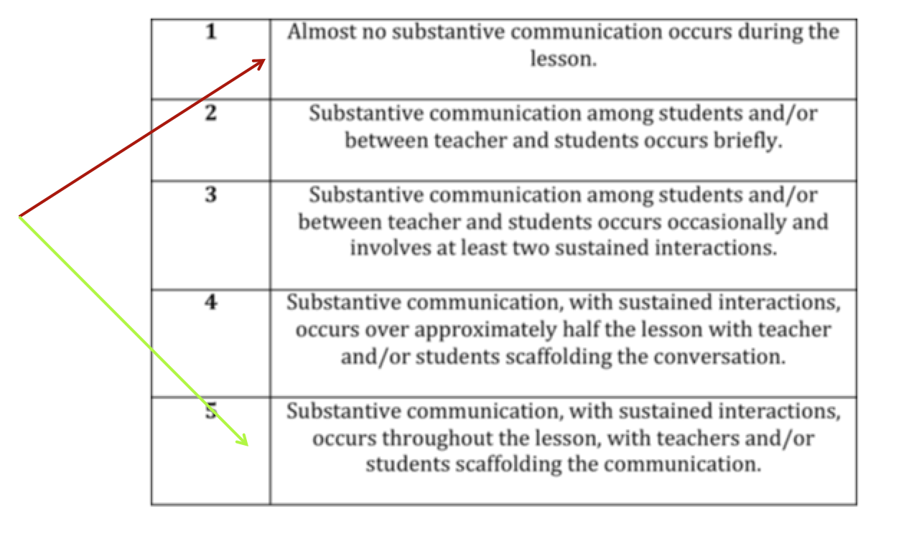
Coding Substantive Communication

Slide 8

AIM OF THE EXPERIMENT
To investigate which instructional strategy support novice and more experienced participants in identifying and applying knowledge of the QTM
To determine how each instructional strategy impacted on the cognitive load of the participants
To investigate how each instructional strategy impacted on the perceived difficulty rated by each participant.

Slide 9

RESEARCH QUESTION
What type of worked example is most effective in supporting pre-service teachers’ understanding of:
what are the characteristics of Substantive
Communication within the NSW Quality Teaching
Model?
how to apply the characteristics of Substantive
Communication that support quality teaching?

Slide 10

Participants
Experiment 1: Early year pre-service teachers
Experiment 2: Final year pre-service teachers
Conditions
Process-Product Oriented Worked Examples
Product Oriented Worked Examples
Conventional Problem Solving

Slide 11
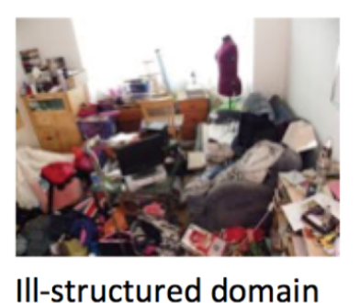

Hypotheses
Performance – understanding
Performance – application
Mental Effort
Task Difficulty
Process-Product WE
>
Product WE
Product WE
>
Conventional Problem Solving
Ill-structured
Environment
Novices

Slide 12

Hypotheses
Performance – understanding
Performance – application
Mental Effort
Task Difficulty
Product WE
>
Process-Product WE
Conventional Problem Solving
>
Product WE
Ill-structured
Environment
High Prior Knowledge

Slide 13
Methodology

Slide 14
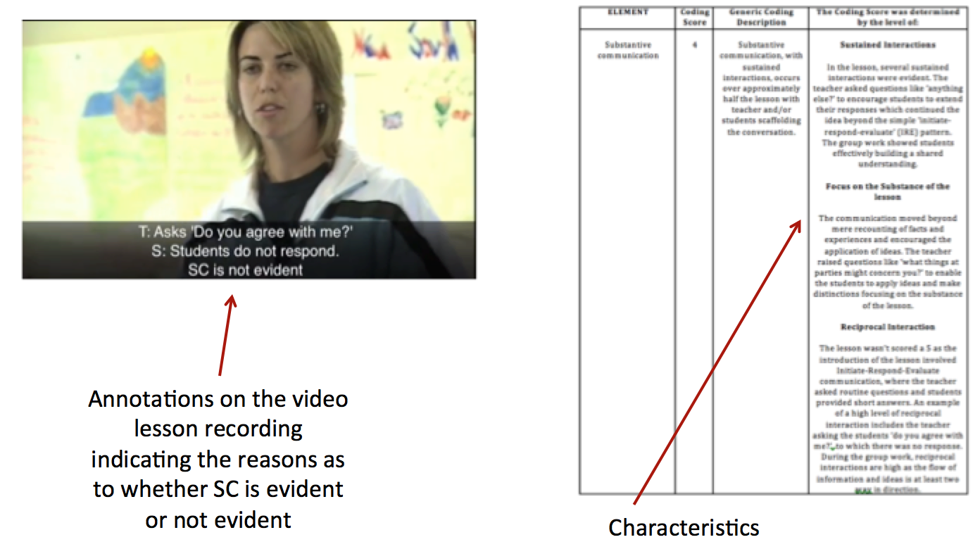
Process-Product Oriented
Worked Example

Slide 15
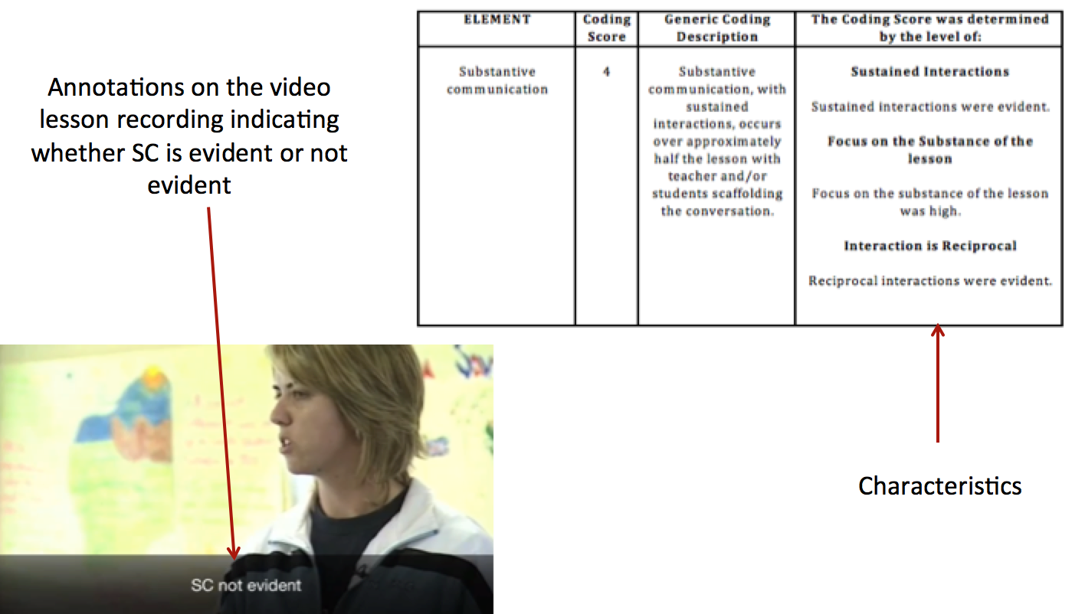
Product-Oriented
Worked Example

Slide 16
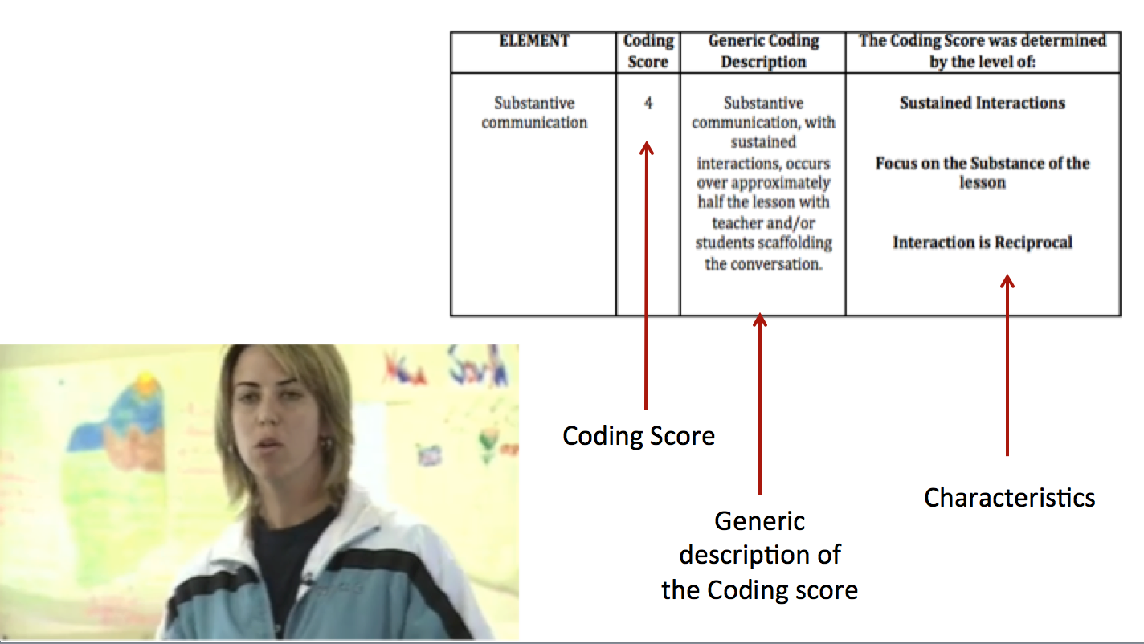
Conventional Problem Solving

Slide 17
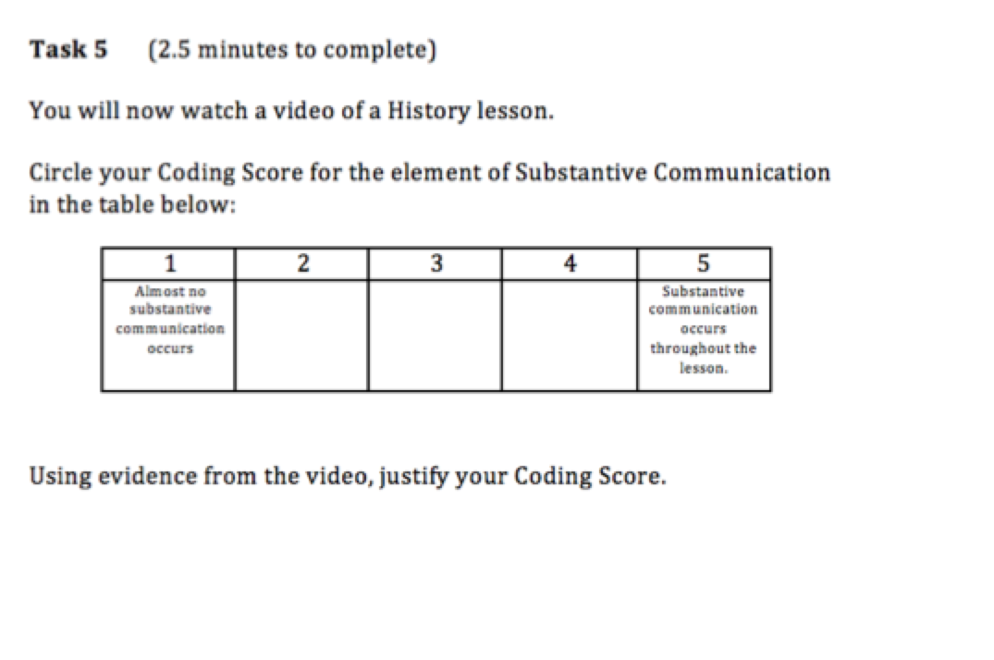
Near-Transfer Task

Slide 18
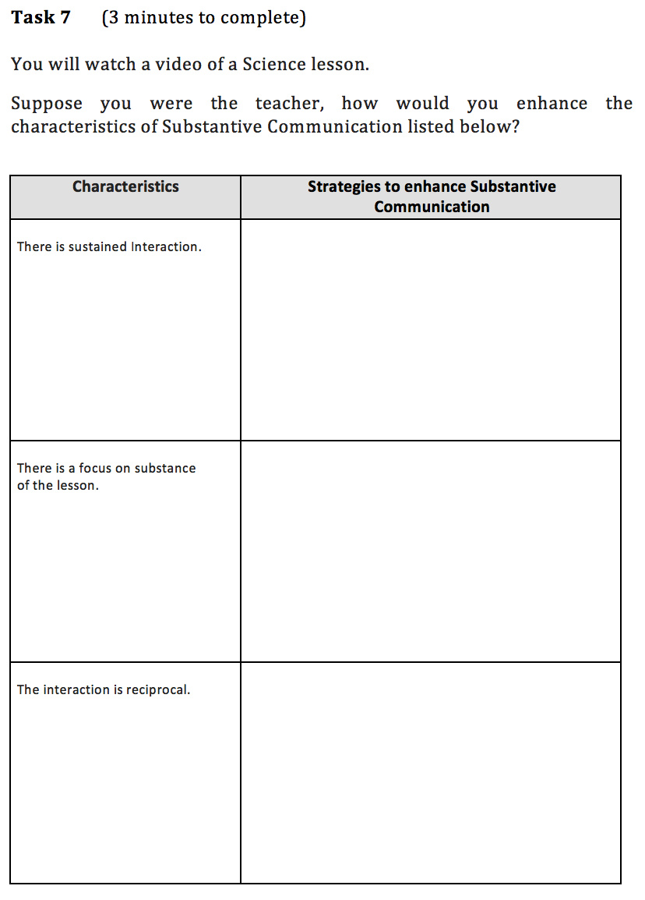
Far Transfer Task

Slide 19
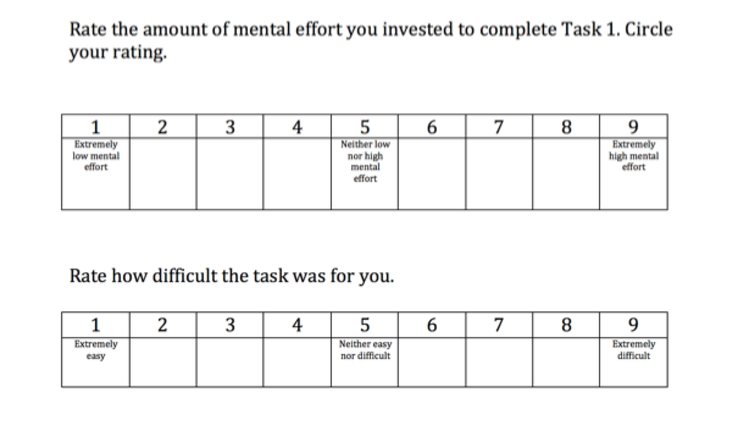

Slide 20
PERFORMANCE SCORES

Slide 21
MENTAL EFFORT RATINGS

Slide 22
TASK DIFFICULTY RATINGS

Slide 23

LIMITATIONS
Length of the experiment – 75 minutes
  “Way too long. 1 to 2 videos demonstrating what was would be enough.”
Timing of the experiment
  “Highly interactive and engaging. Some ran a little too long after the point was made.”
WHERE TO NEXT
Experts study undertaken but limited numbers
Phase 3: Experiments to be conducted with more participants (possibly include teachers) with a focus on participant’s engagement i.e what are they thinking when they engage with different types of Worked Examples

Slide 24

Thank You for Listening
Gerry Sozio
PhD Candidate
University of Wollongong
Early Start Research Institute
gerry.sozio@dow.catholic.edu.au
Catholic Education Diocese of Wollongong
Education Officer Secondary
School Improvement Services
NSW Australia

