Slide 1
Visuospatial Tests Correlate with STEM Animation Learning: Perspectives to Cognitive Load Measurement?
Juan Cristóbal Castro-Alonso¹, Paul Ayres², and Fred Paas^{3,4}
¹ Center for Advanced Research in Education (CIAE), Universidad de Chile, Chile
² School of Education, University of New South Wales, Australia
³ Department of Psychology, Education, and Child Studies, Erasmus University Rotterdam, The Netherlands
⁴ Early Start Research Institute, University of Wollongong, Australia
10th International Cognitive Load Theory Conference
Wollongong, Australia, 20-22 November 2017
PAI 82140021
PIA – Basal FB0003

Slide 2
jccastro@ciae.uchile.cl
DrCrisCastro
www.drcriscastro.com

Slide 3
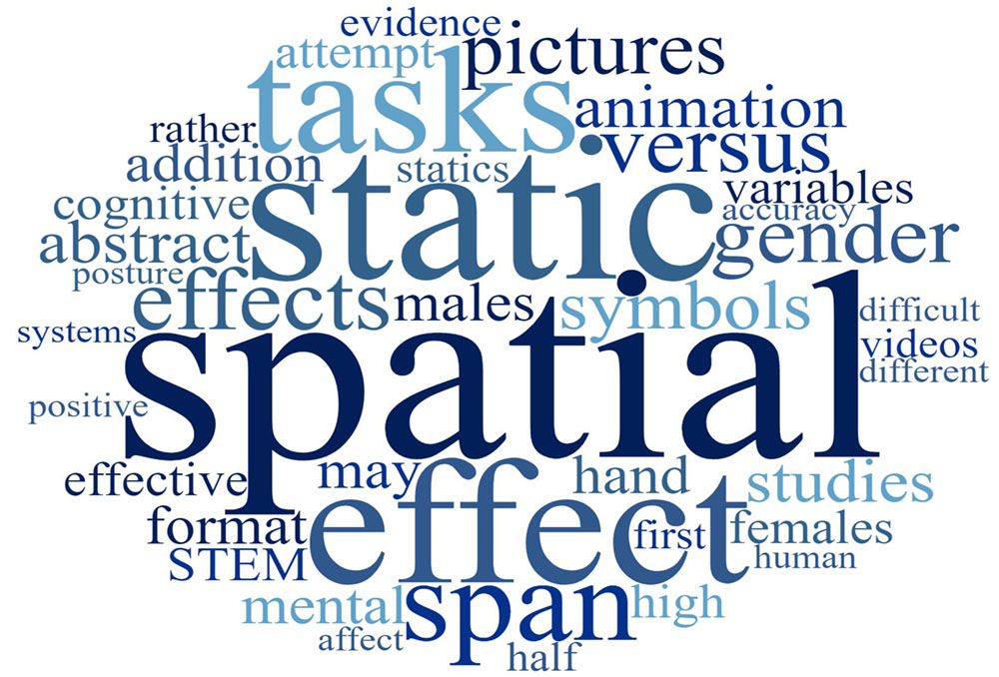

Slide 4
Outline
Cognitive Load and Visuospatial Abilities
Gender and Visuospatial Abilities
STEM and Visuospatial Abilities
The Transient Information Effect
Project PAI 82140021
Battery of 9 visuospatial tests
Novel Card Rotations, Corsi Tapping, Visual Patterns
Experiment
Design, Hypotheses, Methods
Results & Conclusion
1/16

Slide 5
Cognitive Load and Visuospatial Abilities
How to measure cognitive load or working memory load?⁽¹⁾
Working memory includes a visuospatial subcomponent⁽²⁾
The subprocessor is related to spatial ability⁽³⁾
“Skill in representing and transforming symbolic or nonlinguistic information through space.”⁽⁴⁾
Kirschner, P. A., Ayres, P., & Chandler, P. (2011). Contemporary cognitive load theory research: The good, the bad and the ugly. Computers in Human Behavior, 27(1), 99-105. doi: 10.1016/j.chb.2010.06.025
Baddeley, A. (2012). Working memory: Theories, models, and controversies. Annual Review of Psychology, 63(1), 1-29. doi: 10.1146/annurev-psych-120710-100422
Salthouse, T. A., Mitchell, D. R. D., Skovronek, E., & Babcock, R. L. (1989). Effects of adult age and working memory on reasoning and spatial abilities. Journal of Experimental Psychology: Learning, Memory, and Cognition, 15(3), 507-516. doi: 10.1037/0278-7393.15.3.507
Terlecki, M. S., & Newcombe, N. S. (2005). How important is the digital divide? The relation of computer and videogame usage to gender differences in mental rotation ability. Sex Roles, 53(5-6), 433-441. doi: 10.1007/s11199-005-6765-0
2/16

Slide 6
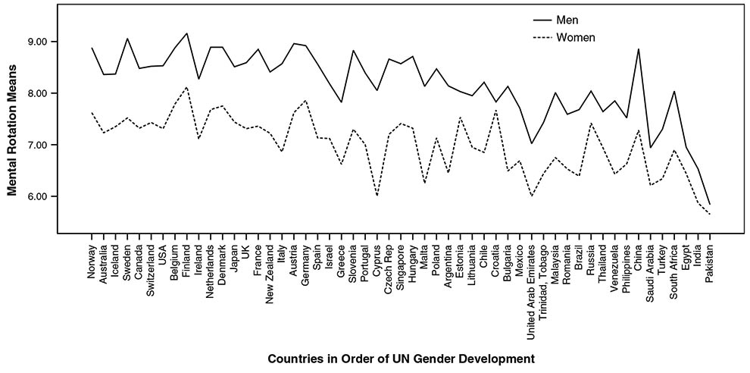
Gender and Visuospatial Abilities
53 countries (N > 200.000, 2010)⁽¹⁾
Lippa, R. A., Collaer, M. L., & Peters, M. (2010). Sex differences in mental rotation and line angle judgments are positively associated with gender equality and economic development across 53 nations. Archives of Sexual Behavior, 39(4), 990-997. doi: 10.1007/s10508-008-9460-8
3/16

Slide 7
STEM and Visuospatial Abilities
STEM learning is aided by spatial ability⁽¹⁾
Mental rotation
Canada (N > 600, 1995): STEM students (biology, physics, and engineering) > non-STEM students (arts, social sciences, and humanities)⁽²⁾
Wai, J., Lubinski, D., & Benbow, C. P. (2009). Spatial ability for STEM domains: Aligning over 50 years of cumulative psychological knowledge solidifies its importance. Journal of Educational Psychology, 101(4), 817-835. doi: 10.1037/a0016127
Peters, M., Laeng, B., Latham, K., Jackson, M., Zaiyouna, R., & Richardson, C. (1995). A redrawn Vandenberg and Kuse Mental Rotations Test: Different versions and factors that affect performance. Brain and Cognition, 28(1), 39-58. doi: 10.1006/brcg.1995.1032
4/16

Slide 8
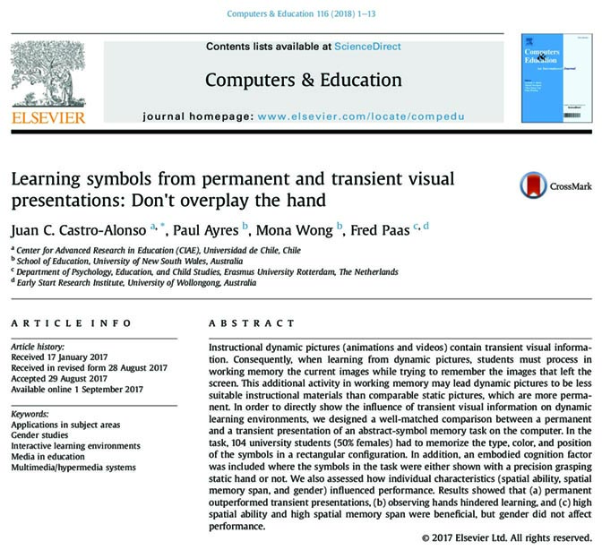
The Transient Information Effect
Three Demanding Tasks for Working Memory^{(1,2)}
Process the current visible information
Remember the previous elements
(no longer visible)
Integrate both streams of information in order to comprehend the material
Ayres, P., & Paas, F. (2007). Making instructional animations more effective: A cognitive load approach. Applied Cognitive Psychology, 21(6), 695-700
Lowe, R. K. (1999). Extracting information from an animation during complex visual learning. European Journal of Psychology of Education, 14(2), 225-244. doi: 10.1007/BF03172967
Castro-Alonso, J. C., Ayres, P., Wong, M., & Paas, F. (2018). Learning symbols from permanent and transient visual presentations: Don't overplay the hand. Computers & Education, 116, 1-13. doi: 10.1016/j.compedu.2017.08.011
5/16

Slide 9
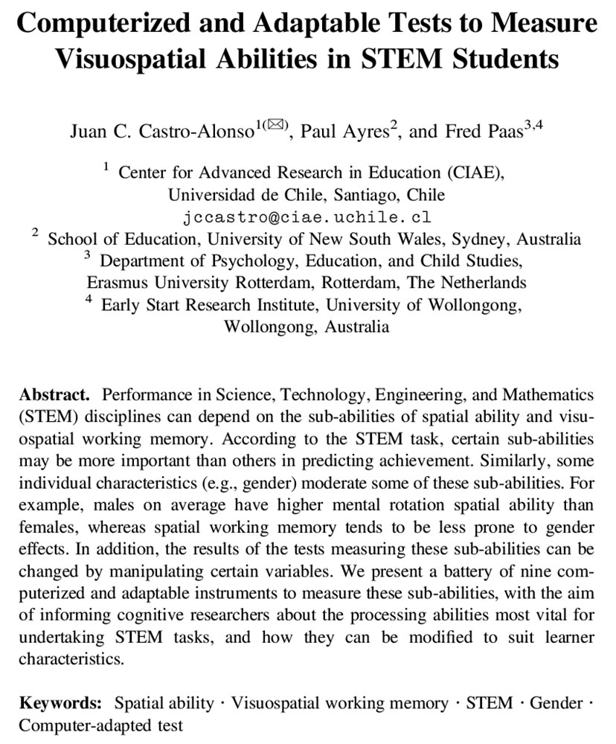
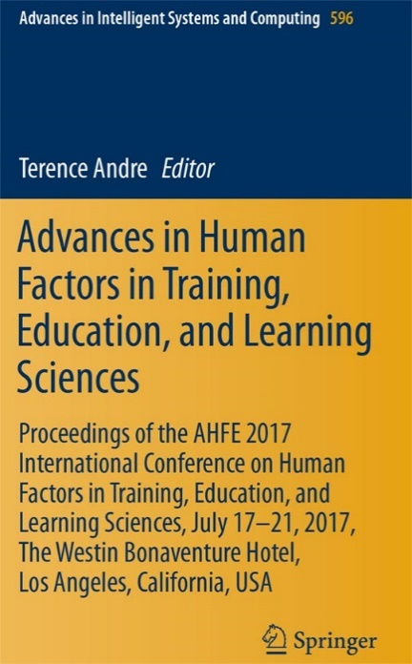
PAI 82140021 Project
Battery of 9 computer instruments
Castro-Alonso, J. C., Ayres, P., & Paas, F. (2018). Computerized and adaptable tests to measure visuospatial abilities in STEM students. In T. Andre (Ed.), Advances in Human Factors in Training, Education, and Learning Sciences: Proceedings of the AHFE 2017 International Conference on Human Factors in Training, Education, and Learning Sciences (pp. 337-349). Cham, Switzerland: Springer. doi: 10.1007/978-3-319-60018-5_33
6/16

Slide 10
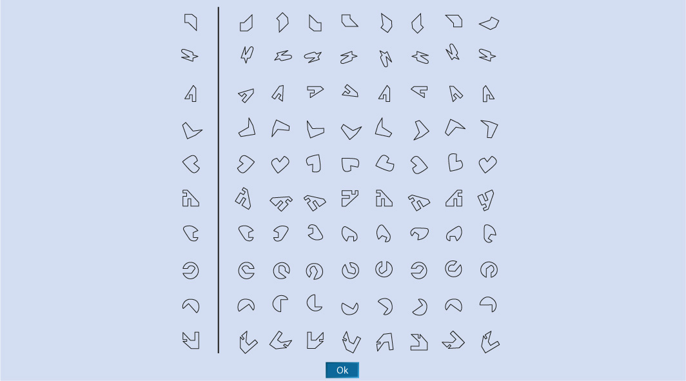
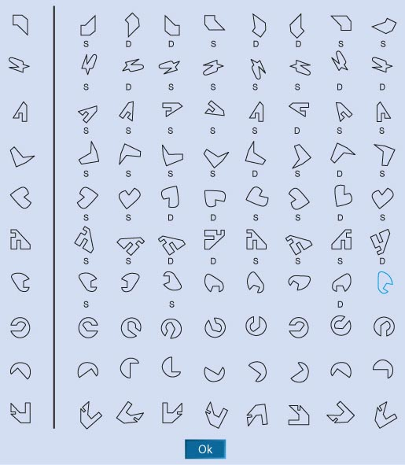
1 - Novel Card Rotations Test
7/16

Slide 11
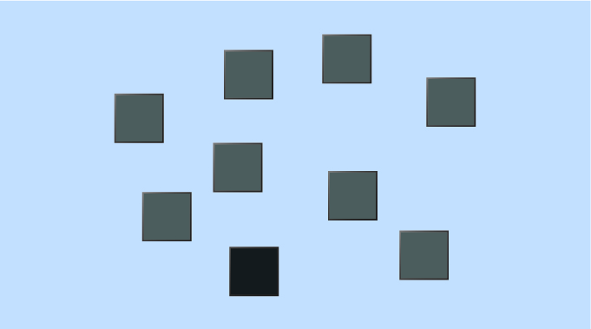
2 - Corsi Tapping Test⁽¹⁾
Milner, B. (1971). Interhemispheric differences in the localization of psychological processes in man. British Medical Bulletin, 27(3), 272-277.
8/16

Slide 12
Corsi Tapping Test
Other variables
Backward test
Block positions
Block color
Display time
Sequences
Language
Instructions
Practices
9/16

Slide 13
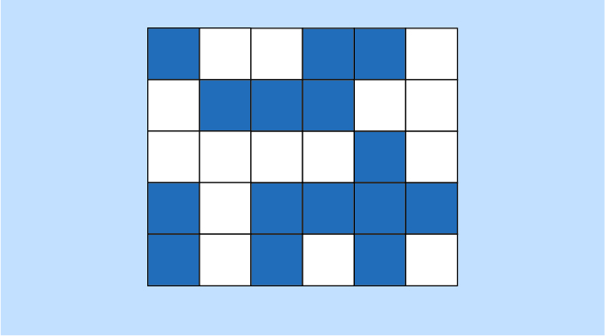
3 - Visual Patterns Test⁽¹⁾
Della Sala, S., Gray, C., Baddeley, A., Allamano, N., & Wilson, L. (1999). Pattern span: A tool for unwelding visuo–spatial memory. Neuropsychologia, 37(10), 1189-1199. doi: 10.1016/S0028-3932(98)00159-6
10/16

Slide 14
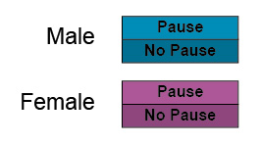
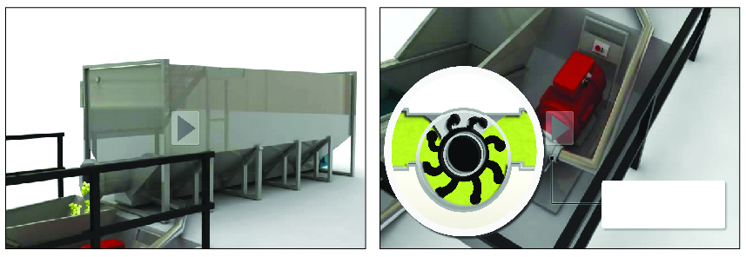
Experiment
Mixed Design
Within-subjects:
3 tests (Novel CRT, Corsi, VPT)
+ STEM task (vinification)
Between-subjects:
11/16

Slide 15
Hypotheses
H1: Males > Females in the 3 Tests + STEM task
H2: Positive correlations between the STEM task and the 3 Tests
H3: For the STEM task, Pause > No Pause
12/16

Slide 16
Methods
80 Chilean STEM technical students (50% W, M = 21.43 years)
Not all did backward Corsi, so N = 75:
18 Male/Pause, 19 Male/No Pause, 20 Females/Pause, 18 Females/No Pause
Order:
Novel Card Rotations Test
Corsi Tapping Test
Visual Patterns Test
Animation (Pause vs No Pause)
Multimedia Retention Test
13/16

Slide 17
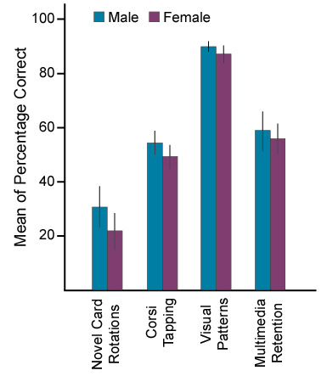
Results
Within-subjects
F = 218.15, p < .001, $_{P}^{2}$ = .75
Between-subjects
F = 4.43, p = .039, $_{P}^{2}$ = .06
Males M = 58.16 [54.85–61.46]
Females M = 53.25 [49.99–56.52]
14/16

Slide 18
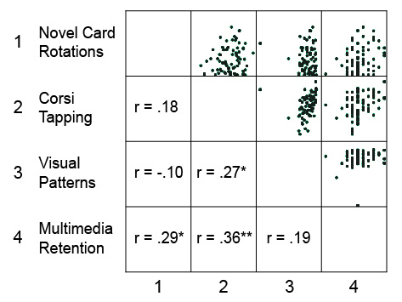
Results
Correlations
15/16

Slide 19
Conclusion
In order of difficulty:
Visual Patterns Test < Retention Test = Corsi Tapping Test < Novel Card Rotations Test
H1: Males would show higher scores than females in the four tasks
Overall male advantage, but not for individual tasks
H2: The scores in the three visuospatial tests would be positively correlated with the scores in the retention test
Visual Patterns Test did not correlate with the Multimedia Retention Test
H3: The pause animation condition would show higher scores in the retention test than the no pause condition
16/16

